Slide 1


Dept of AIML

Slide 2
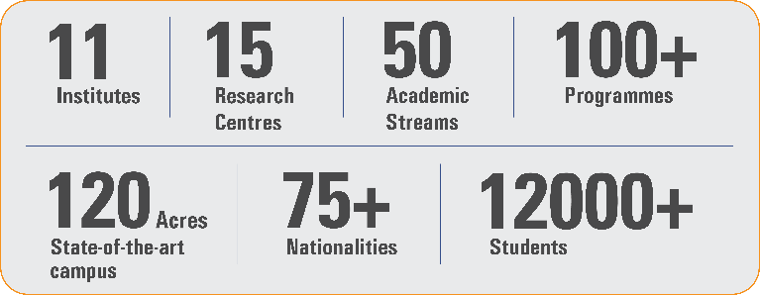
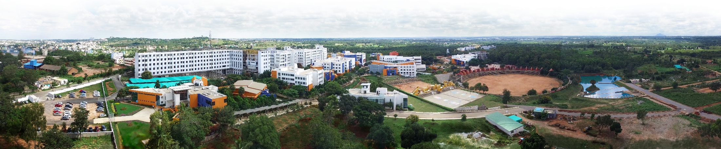
Overveiw
Acharya stands as a beacon of excellence in higher education, boasting a legacy of academic distinction since its establishment in 1990. We offer a transformative educational experience, fostering holistic development, nurturing innovation and providing world-class facilities to ensure an enriching journey for our students.
Dept of AIML

Slide 3
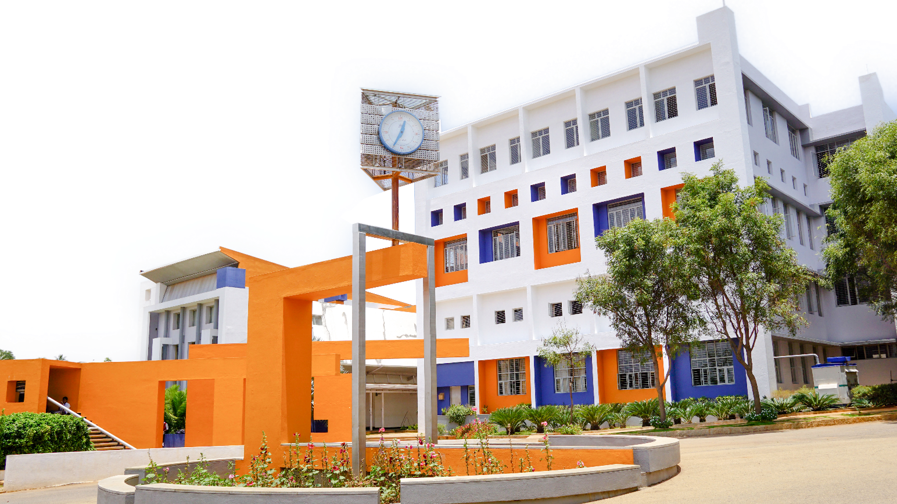
11 Institutions, Infinite Possibilities
We provide 100+ programs across 50 academic streams.
Dept of AIML

Slide 4
Cloud Computing and Security (BIS613D)
MODULE-2
Virtual Machines and Virtualisation of Clusters and Data Centres
Implementation Levels of Virtualisation
Virtualisation Structure/Tools and Mechanisms
Virtualisation of CPU/Memory and I/O devices
Virtual Clusters and Resource Management
Virtualisation for Data Centre Automation.
Dept of AIML

Slide 5
Introduction to Virtualization
A Virtual Machine (VM) is a software-based computer that runs:
Its own Operating System
Applications
Virtual CPU
Virtual Memory
Virtual Disk
Dept of AIML

Slide 6
Introduction to Virtualization
Virtualization is the process of creating virtual versions of computing resources such as servers, operating systems, storage, or networks on a single physical machine.
This enables multiple virtual machines (VMs) to run independently on shared hardware, improving resource utilisation and flexibility.
Dept of AIML

Slide 7
Evolution of Distributed Computing
Shift from centralised mainframes to distributed Internet systems
1950–1970 – Mainframes (e.g., IBM 360): Used by big companies and governments.
1960–1980 – Minicomputers (e.g., PDP-11): Used in colleges and small businesses.
1970–1990 – Personal Computers: Built using microprocessors (VLSI).
1980–2000 – Portable Devices: Laptops, mobiles in wired/wireless networks.
Since 1990 – Clusters, Grids & Clouds: Use High Performance and High Throughput system
Dept of AIML
Key Shift:
From centralized computing → to parallel and distributed computing → to cloud computing and IoT

Slide 8
Evolution of Distributed Computing
Feature | Traditional Computing | Virtualized Computing
Hardware usage | Dedicated to one OS | Multiple VMs share hardware
OS execution | One OS per machine | Multiple OS on same machine
Resource utilization | Often underutilized | Efficient sharing
Isolation | Applications share same OS | Each VM isolated
Dept of AIML

Slide 9
Implementation Levels of Virtualization
1. Instruction Set Architecture (ISA) Level
Emulates CPU instruction set.
Allows programs compiled for one CPU to run on another.
Example: QEMU
2. Hardware Level Virtualization
Uses a hypervisor (Virtual Machine Monitor – VMM) between hardware and OS.
Creates multiple VMs.
Example: VMware ESXi, Xen
Dept of AIML

Slide 10
Implementation Levels of Virtualization
3. Operating System Level
One kernel manages multiple isolated user spaces.
Lightweight virtualization.
Example: Docker containers, LXC
4. Library Level Virtualization
Applications interact with a virtualization library.
Provides compatibility layer.
Example: Wine
Dept of AIML

Slide 11
Implementation Levels of Virtualization
Application Level Virtualization
Application runs in its own virtual environment.
Example: Java Virtual Machine (JVM)
Dept of AIML

Slide 12
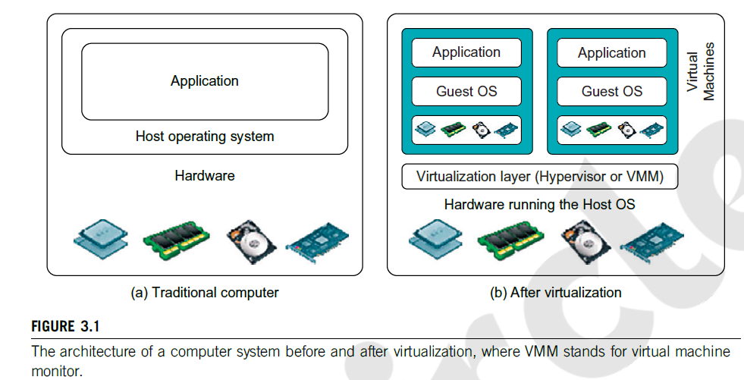
Implementation Levels of Virtualization
Dept of AIML

Slide 13
Virtualization Structure, Tools, and Mechanisms
Hypervisor (Virtual Machine Monitor)
A hypervisor manages virtual machines and allocates hardware resources to them.
Types of Hypervisors
Type-1 (Bare-Metal)
Runs directly on hardware.
Examples:
VMware ESXi
Xen
Microsoft Hyper-V
Dept of AIML
Type-2 (Hosted)
Runs on top of an existing OS.
Examples:
VMware Workstation
VirtualBox

Slide 14
VMM Design Requirements
A VMM must:
Provide identical environment as real machine
Maintain efficient performance
Control all system resources
Dept of AIML

Slide 15
Virtualization Structure, Tools, and Mechanisms
Virtualization Techniques
1. Full Virtualization
Guest OS runs without modification.
Uses binary translation.
Example: VMware.
2. Para-Virtualization
Guest OS is modified to communicate with hypervisor.
Improves performance.
Example: Xen.
Dept of AIML

Slide 16
Virtualization of CPU, Memory, and I/O
CPU Virtualization
Hypervisor allocates CPU cycles to VMs.
Uses time sharing or scheduling algorithms.
Memory Virtualization
Virtual memory mapped to physical memory.
Techniques:
Shadow page tables
Extended page tables
Dept of AIML
Examples
Intel VT-x
AMD-V

Slide 17
Virtualization of CPU, Memory, and I/O
I/O Virtualization
Allows multiple VMs to share devices such as:
Disk
Network interface
GPU
Methods:
Device emulation
Direct I/O assignment
Dept of AIML

Slide 18
Virtualization of CPU, Memory, and I/O
Hypervisor | Architecture
VMware Workstation | Full virtualization
Xen | Hypervisor
KVM | Para virtualization
Dept of AIML

Slide 19
Virtual Clusters and Resource Management
Virtual Cluster
A cluster where nodes are virtual machines instead of physical machines.
Benefits:
Dynamic scaling
Flexible resource allocation
Easy migration of VMs
Resource Management Techniques
VM scheduling
Load balancing
Resource provisioning
VM migration
Dept of AIML

Slide 20
Virtualization for Data Center Automation
Virtualisation enables automated management of data centres.
Key Features
Automated provisioning
Dynamic scaling
Energy optimization
Fault tolerance
Examples in Cloud Platforms
AWS EC2
Google Cloud VM
Microsoft Azure VM
Automation tasks:
VM creation
Load balancing
Resource scaling
Monitoring
Dept of AIML

Slide 21
Hypervisor Architecture
Hypervisor sits between hardware and OS
Manages CPU, memory, and devices
Example:
Xen Hypervisor
Dept of AIML

Slide 22
Xen Architecture
Components:
Hypervisor
Domain 0
Domain U
Domain 0
Privileged control domain
Domain U
Guest OS domains
Dept of AIML
Dom0 is the initial domain started by the Xen hypervisor on boot.
Dom U It hosts applications, databases, or operating systems for users.

Slide 23
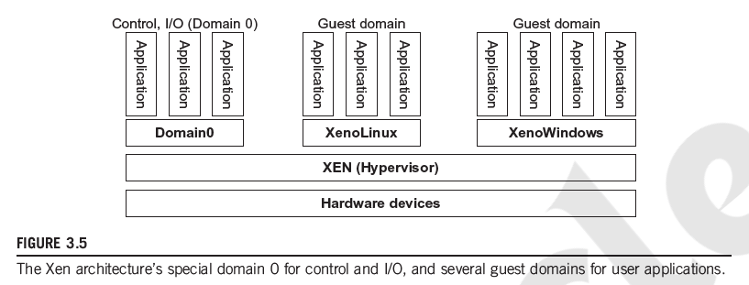
Xen Architecture
Dept of AIML

Slide 24
Virtualization Mechanisms
Full Virtualization
Guest OS runs without modification
Uses binary translation
Example
VMware
Dept of AIML

Slide 25
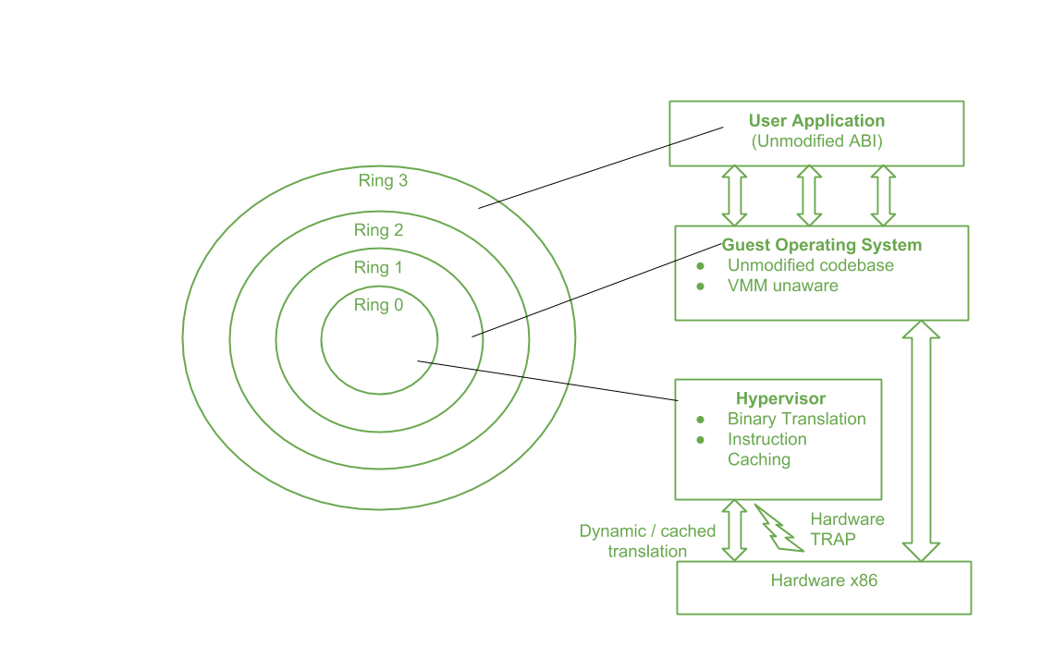
Full Virtualization
Dept of AIML

Slide 26
Binary Translation
Sensitive instructions are trapped to VMM
Non-critical instructions executed directly
Performance:
80–97% of native system speed
Dept of AIML

Slide 27
Host-Based Virtualization
Virtualization layer installed above host OS
Advantages
Easy deployment
Disadvantages
Lower performance
Dept of AIML

Slide 28
Para-Virtualization
Guest OS modified to interact with hypervisor
Uses hypercalls
Examples
Xen
KVM (Kernel VM)
Dept of AIML

Slide 29
Para-Virtualization
VM instructions classified as:
Privileged instructions
Control sensitive instructions
Behaviour-sensitive instructions
Hypervisor traps critical instructions.
Dept of AIML

Slide 30
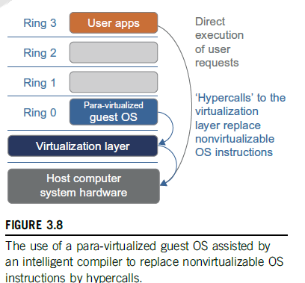
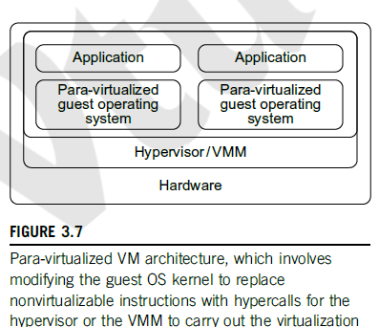
Para-Virtualization
Dept of AIML

Slide 31
Hardware Assisted CPU Virtualization
Processors provide additional modes:
Root mode for hypervisor
Guest mode for VMs
Dept of AIML

Slide 32
Memory Virtualization
In virtual environments:
Two-level memory mapping
Virtual → Guest physical memory
Guest physical → Machine memory
Dept of AIML

Slide 33
Memory Virtualization Mechanisms
Page tables
MMU (Memory Management Unit)
TLB caching
Dept of AIML

Slide 34
I/O Virtualization
Allows multiple VMs to share devices.
Devices include:
Disk
Network
GPU
Techniques:
Device emulation
Direct assignment
Dept of AIML

Slide 35
Virtual Clusters & Data Centers
A cluster where nodes are virtual machines instead of physical servers.
Benefits
Scalability
Flexibility
Cost efficiency
Dept of AIML

Slide 36
Resource Management
Key tasks:
VM scheduling
Load balancing
Resource allocation
VM migration
Dept of AIML

Slide 37
Data Center Virtualization
Virtualization enables:
Automated provisioning
Dynamic scaling
Fault tolerance
Dept of AIML

Slide 38
Virtualization in Cloud Platforms
Examples
Amazon EC2
Microsoft Azure
Google Cloud
Dept of AIML

Slide 39
Advantages of Virtualization
Efficient resource usage
Reduced hardware cost
Improved scalability
Easy system recovery
Faster deployment
Dept of AIML

Slide 40
Challenges of Virtualization
Security risks
Performance overhead
Resource management complexity
Dept of AIML

Slide 41
Challenges of Virtualization
Security risks
Performance overhead
Resource management complexity
Dept of AIML

Slide 42
Challenges of Virtualization
Security risks
Performance overhead
Resource management complexity
Dept of AIML

